Slide 1



TM
SONG FACTORY
MUSIC CREATION PROGRAM
CHOSEN AS ONE OF THE TOP 6 INNOVATIVE PRACTICES IN USA AND CANADA
BY THE COUNCIL ON ACCREDITATION

Slide 2
SOUNDCHECK
HOW LOUD IS THIS THING
LET’S FIND OUT
CHOSEN AS ONE OF THE TOP 6 INNOVATIVE PRACTICES IN USA AND CANADA
BY THE COUNCIL ON ACCREDITATION

Slide 3

SOUNDCHECK
HOW LOUD IS THIS THING
CHOSEN AS ONE OF THE TOP 6 INNOVATIVE PRACTICES IN USA AND CANADA
BY THE COUNCIL ON ACCREDITATION

Slide 4
SOUNDCHECK
WAS THAT LOUD ENOUGH?
CHOSEN AS ONE OF THE TOP 6 INNOVATIVE PRACTICES IN USA AND CANADA
BY THE COUNCIL ON ACCREDITATION

Slide 5


TRAUMA INFORMED CATHARSIS THROUGH THE CREATION OF MUSIC AND LYRICS
“Today, I am proud to say that due to this program I have made it to safety and I now have freedom to express who I am."
-Program Participant

Slide 6
Chosen as one of the
Top 6 Innovative Practices in the US and Canada
by the Council on Accreditation
The Council on Accreditation currently accredits (or is in the process of accrediting) over 1600 organizations that serve more than 7 million individuals and families in the U.S. and Canada.

Slide 7
Life is like waves
Like the sea, like a maze
In a stormy ocean
Of my emotions
I am reeling
From my feelings
Pray to the lord
To keep me on board
My sinking ship
EMOTION OCEAN
(EXCERPT)

Slide 8
Life is like waves
Like the sea, like a maze
In a stormy ocean
Of my emotions
I am reeling
From my feelings
Pray to the lord
To keep me on board
My sinking ship
EMOTION OCEAN
(EXCERPT)

Slide 9
My mother left me at age 11
kinda put me in a depression
started problems, and it started tension
she has a new baby, and it made me question
is that love? is that love?
My parents solved problems
with men women and thugs
but not once asked me if I needed a hug
What is love? What is love?
my ex boyfriend told me he loved me
and yes he always hugged me
treated me right then pulled out the knife
Now he thinks he’s above me
He made me Bleed,
He’d accuse and plead
that he never hurt me
the bruises on me
nobody could see
16 year old girl
now I may be young
I’m living in a big world
I don’t know how to love/
I don’t want to love
LOVE
(EXCERPT)

Slide 10
Drugs are why I got taken away
dad started selling drugs to survive
divorced parents, I was homeless
I was stealing drugs, so I could get high
I’d be going through withdrawal
dad coming to my visits
high on heroin, nodding out
I really want to see him
he’s going down the wrong path
stop before it’s too late
seen people overdose
wonder why I’m full of hate
I wish you would change
for me and not you
Spend your money on drugs
can’t even buy yourself food
It’s just sad
that I’m changing for you
and my parents can’t change
I don’t know what to do
You say there’s nothing for you
but you have a whole kid
I know you have a new one
forget the stuff you did
She got so high
I had to crop her out of a couple photos
Seen Xanax dripping down her nose
that’s a no-no
LOVE
(EXCERPT)

Slide 11
are you mad at me?
what did I do wrong?
Is it my fault?
That you took a break,
and I don’t know for how long
are you gonna leave me?
Have I misspoken?
I’m not gonna be there
I feel like a piece of my mirror will be broken
each piece of the mirror is a different friend
one friend goes, and it’s missing then
I look different in the reflection
So close but so far from perfection
Feel like I’m frozen
I can’t move but I don’t know it
watching and I can’t move on
takes me back to my dad beating my mom
MOOD
SWINGS
AAI | Pro X

Slide 12
I can’t breathe
What did it do to me?
What...I didn’t win?
I’m underwater and I can’t swim
Standing on the ocean
something pulls you down
broken emotions
make you drown
Broken emotions
What do I do now?
MOOD
SWINGS
Extremely intense
hyperventilate
terrified, sad
The trigger is a punch to the face
Like a bullet hitting your brain
can’t get over the pain
I’m scared of myself
emotions are hell
AAI | Pro X

Slide 13
The pain and the anger is like a volcano
that keeps going off, I’m like a tornado
It’s destructive, It’s like puking
Tensed up, pent up, here comes the mood swing
head keeps pounding
I can barely think
slamming doors, throwing everything
can’t find my happy place
I can’t calm down
extremely aggressive
What day is it now?
Eventually I hurt someone
and then they leave
as soon as they do I come back to being me
screaming, crying
officially dying
Running away
Am I even trying?
Telling myself doubts
like a conversation
I don’t like you
is that hatred?
IT’S NOT TRUE
you’re not doing your best
you’re not working hard enough
You’re a mess
MOOD
SWINGS
AAI | Pro X

Slide 14

CRITERIA
Ages 8 and up
No musical ability required.
No reading/writing ability required.
Interest in songwriting, music, poetry, or storytelling.
Trauma history/need for therapeutic intervention.
Must have social worker or counselor willing to collaborate.

Slide 15
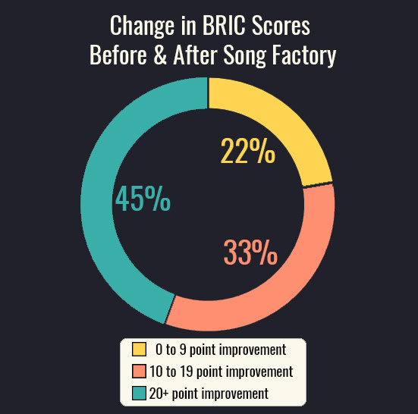
IMPROVED BEHAVIOR
Song Factory uses the Behavioral Rating Index for Children (BRIC) to assess progress with negative behaviors. Behaviors are assessed before and after the program, on a scale of 1 to 100 with 100 representing the most severe behaviors. Participants have demonstrated an average behavior improvement of 14 points, with numerous youth making improvements upwards of 35 points.

Slide 16
MORE HOPE
STRONGER ALLIANCES
Song Factory also uses the Hopelessness Scale for Children (HSC) to measure quantitative results. This rapid assessment instrument gauges hopelessness on a scale from 1 to 17. Participants have demonstrated an average increase in hopefulness of 2 points, with no cases of negative change.
Our data indicates that Song Factory also assists participants in developing
a relationship with their support network. We have measured participants' willingness to be open with their social workers over the course of Song Factory, and we have seen an average of 4 points of improvement on a scale from 1-10.

Slide 17

"I truly believe this program saved my client's life."
-Participant's Case Worker
96%
98%
Attendance (out of over 450 sessions 2018-2021)
Program satisfaction
“Thank you so much for working with me. This feels so good to get off my chest."
-Program Participant
“I was scared that my songs wouldn't turn out well, but when I heard them it hit me, like REALLY hit me, and I loved it."
-Program Participant
“It lets me get my emotions out."
-Program Participant

Slide 18

"Lately, if she doesn’t know something, she asks.
She never did that before. She’s allowing
herself to express herself and put it in music, and talking
about stuff she’s been through in her life for
the first time...The program really did a lot.
[Song Factory] opened her eyes;
she has learned that it’s
okay to feel.”

Slide 19

"On a scale from 1 to 10, this is a million gazillion billion!"
“I’m so happy I could break into a million tiny pieces of love.”

Slide 20
I’m invisible
my friendships are slipping
I’m paint on the wall
getting older and chipping
this year changed me
for the worse
I’ve been really stressed
what’s wrong with me?
I’m worried for
what comes next
FOR THE WORSE
(EXCERPT)
AAI | Pro X

Slide 21
Roll of thunder
Hear my cry
Over the water
Bye and bye
Ole man comin’
Down the line
Whip in hand to
Beat me down
But I ain’t
Gonna let him
Turn me around*
Dear God, I know you’re there, God
and I know you know that I had my
door locked
My lights off, s**t,
I was wearing nothing but a sports bra
and my shorts with some socks on
Got a sharp knife too feeling me
piercing my body
letting all the blood gush outta me
I’m silent but they banging on my door
sound like thunder
and the slits on my wrist
felt like they were shockin me
Now I can feel my soul
driftin in and outta me
I gotta get control
my life is a catastrophe
all I hear is demons,
all they doin is tellin me
“girl give up your soul, give us control”
S**t, I just don’t what to do, Lord.
That’s why I turn and look to you, Lord
Why couldn’t I stay in heaven with you?
Cause out here I just feel like a fool
Runnin round town doin all these drugs
wrong place wrong time
looking for the right love
that’s why I stay quiet I’m moving in silence
I could be a legend the story I’m writing
them demons I’m fighting I’m tired of crying
but I am not running, the summit I’m climbin
you throwing punches my faith got me duckin
temptation, I love it, my conscience say f*** it
HALLELUJAH
(EXCERPT)

Slide 22
She asks for help
you see her wave you down
you look the other way
Is this meant to be
she shouldn’t have to wonder
where she’s staying tonight
When she screams, do you hear it?
She’s only 15
She is floating
Trying to put her thoughts into motion
She shouldn’t have to feel lost
in the middle of the ocean
holding on to ice
hands slip
trying to grip
the little bit of faith she has left
OCEAN
(EXCERPT)
AAI | Pro X

Slide 23
A little mad because of mistakes
feeling your heart break
so feel whatever you feel,
it helps you heal
Don’t lie, don’t argue
but I did it anyway, I can’t stop!
if you’re having a bad time,
talk to someone, it helps a lot
you wear your actions and mistakes like a sweater
your family puts love in, it makes it better
GOOD STUFF
(EXCERPT)
AAI | Pro X

Slide 24
You could get taken away
And never see your friends again
Never see your family
Till your time has been spent
Got a concussion
Nose bleed
Black and blue eyes
More than a few times
I wish people knew
I’m a good person
I wish I knew
How to stop fighting
Because I was lying
Because I was lying
No one wants me
I was crying
So I’m done
I won’t
I want to make friends
I wrote this song so you would know
Never fight and never lie
It could ruin your life
It’s not worth it
You could be perfect
Never fight and never lie
WHAT
HAPPENED
TO
ME
(EXCERPT)
AAI | Pro X

Slide 25
I thought that I had killed you
Grandma said that wasn’t so
I’ve been hating myself guilty
It’s hard to let that go
You only showed your anger
All the rest was hidden
I wish I got to know you
But I’m kind of glad I didn’t
I loved him.
I don’t love that he hurt me.
I LOVED HIM
(EXCERPT)
AAI | Pro X

Slide 26
Meow meow meow
Purr purr purr
Meow meow meow
Purr purr purr (hiss)
It's not easy being a cat
people often say I'm lazy and fat
I wish I had every variety of fish
Every night a delectable dish
So misunderstood
just trying to live out my cat-hood
Meow meow meow
Purr purr purr (hiss)
OH,
WHAT IT'S LIKE
TO BE A CAT
(EXCERPT)
AAI | Pro X

Slide 27
I keep finding you now
Doped up on the couch
Mom, you gotta go to bed
Am I supposed to let you die?
I’ll cover you with a blanket instead
It’ll never ever ever cover the pain
Was I supposed to let you die?
“PAIN”
(EXCERPT)
AAI | Pro X

Slide 28
Can’t help my heart going
beat, beat, beat
to the tune of my thoughts
playing on repeat
stuck in my head with no escape route
can’t outrun the fear of letting it out
I’m trying
even though I’m dying
I won’t make a mark
But you won’t ever know, I’ll shut you out, stay in the dark
I want to be honest
but I don’t want to be the girl
who’s not allowed around butter knives
Can’t be honest no matter
how many times I’ve tried
Looping through days
drifting past years
Too many thoughts going through my head
Wake me up when I’m not so numb, don’t want to get out of bed
BEAT
BEAT
BEAT
(EXCERPT)
AAI | Pro X

Slide 29
I was abused and suicidal
it was stuck on my mind
I turned around and took it out on you
Instead of being kind
I wish you could see
The person I want to be
Without bridges burnt
Because it hurts to hurt
IT HURTS TO HURT
(EXCERPT)
AAI | Pro X

Slide 30
That’s when I realized
I can change the world
I can change my state of mind
I can change this girl
No matter what
I will never give up
Never Give Up! (Hey!)
“NEVER GIVE UP”
(EXCERPT)
FEATURING CHORUS OF CHILDREN
IN
GROUP HOME
AAI | Pro X

Slide 31
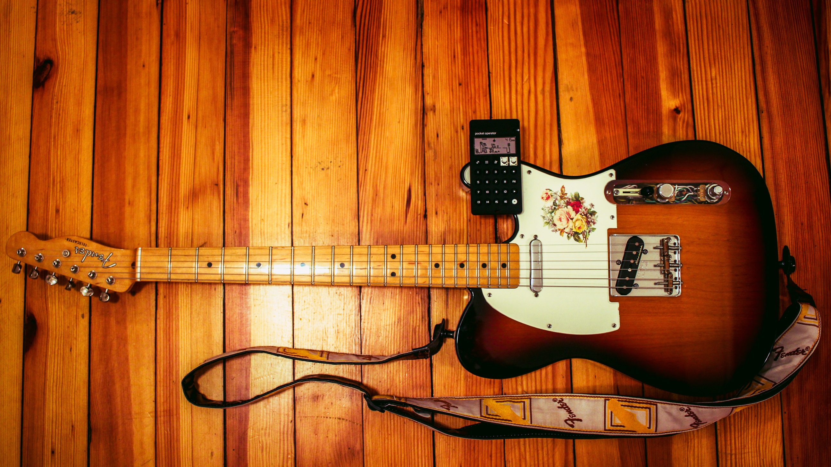
WE WILL COME TO YOU!
Fully portable studio
Partnership with school faculty and clinical/support staff
Comparable to music lesson scheduling
Flexible session length and program duration

Slide 32

GET IN TOUCH!
Drop your business card in the box or join our email list to get occasional updates on program availability and exciting news!
Scan the QR code on our business card for more music, testimonials, and information.
JAMES GLASGOW
songfactorynewyork@gmail.com
(845) 419-8495
songfactoryNY.com

Slide 33
I feel like a steam ship
Hit by an iceberg
I can either go under
or destroy the ice
Life is like waves
Like the sea, like a maze
Like a calm ocean
Of my emotions
I am not reeling
From my feelings
Pray to the lord
To keep me on board
My sailing ship
EMOTION OCEAN
(EXCERPT 2)

